Slide 2
Know what the key employability skills are
Understand the variety of employability skills
Understand how these skills can be used in the workplace

Slide 3
Key Skills are basic skills that affect everything else you do!
Employers, colleges and universities value Key Skills, they can help you get into the job or course you want. Key Skills widen your job choice now and they’ll give you flexibility in job and career moves throughout your life. They’re even pretty useful in your personal life!

Slide 4
Team Work
Risk Management
Negotiating and Influencing
Effective Communication
Creativity and Innovation
Positive Attitude
Initiative
Organising and Planning
Decision Making – Problem Solving
Leadership
Making Decisions – Ethical and Economic
Financial Literacy
Product and Service Design

Slide 6
You have been challenged to build the highest free-standing structure that can support the weight of the golf ball
The structure must not be fixed to the desk
The golf ball must not be fixed to the structure
The golf ball must be held within 20cm of the top of the tower
You can use any of the items in your pack

Slide 7
1 x Stationery Pack
1 x Newspaper
5 x Pieces of card
1 x Golf Ball
30 x Straws

Slide 8
Task | Points
Efficiency award | 10
Creativity award | 10
Height of tower | 1 point per centimetre
All Equipment checked & returned | 5
Teamwork | 5
Golf Ball | 20

Slide 9
5 minutes intro
10 minutes discussion & questions (no building during this time)
30 build time
5 minute warning
10 minutes judging

Slide 10
 | Team 1 | Team 2 | Team 3 | Team 4 | Team 5
Team Name
Efficiency award
Creativity award
Height of tower
Equipment
Teamwork
Golf Ball

Slide 11
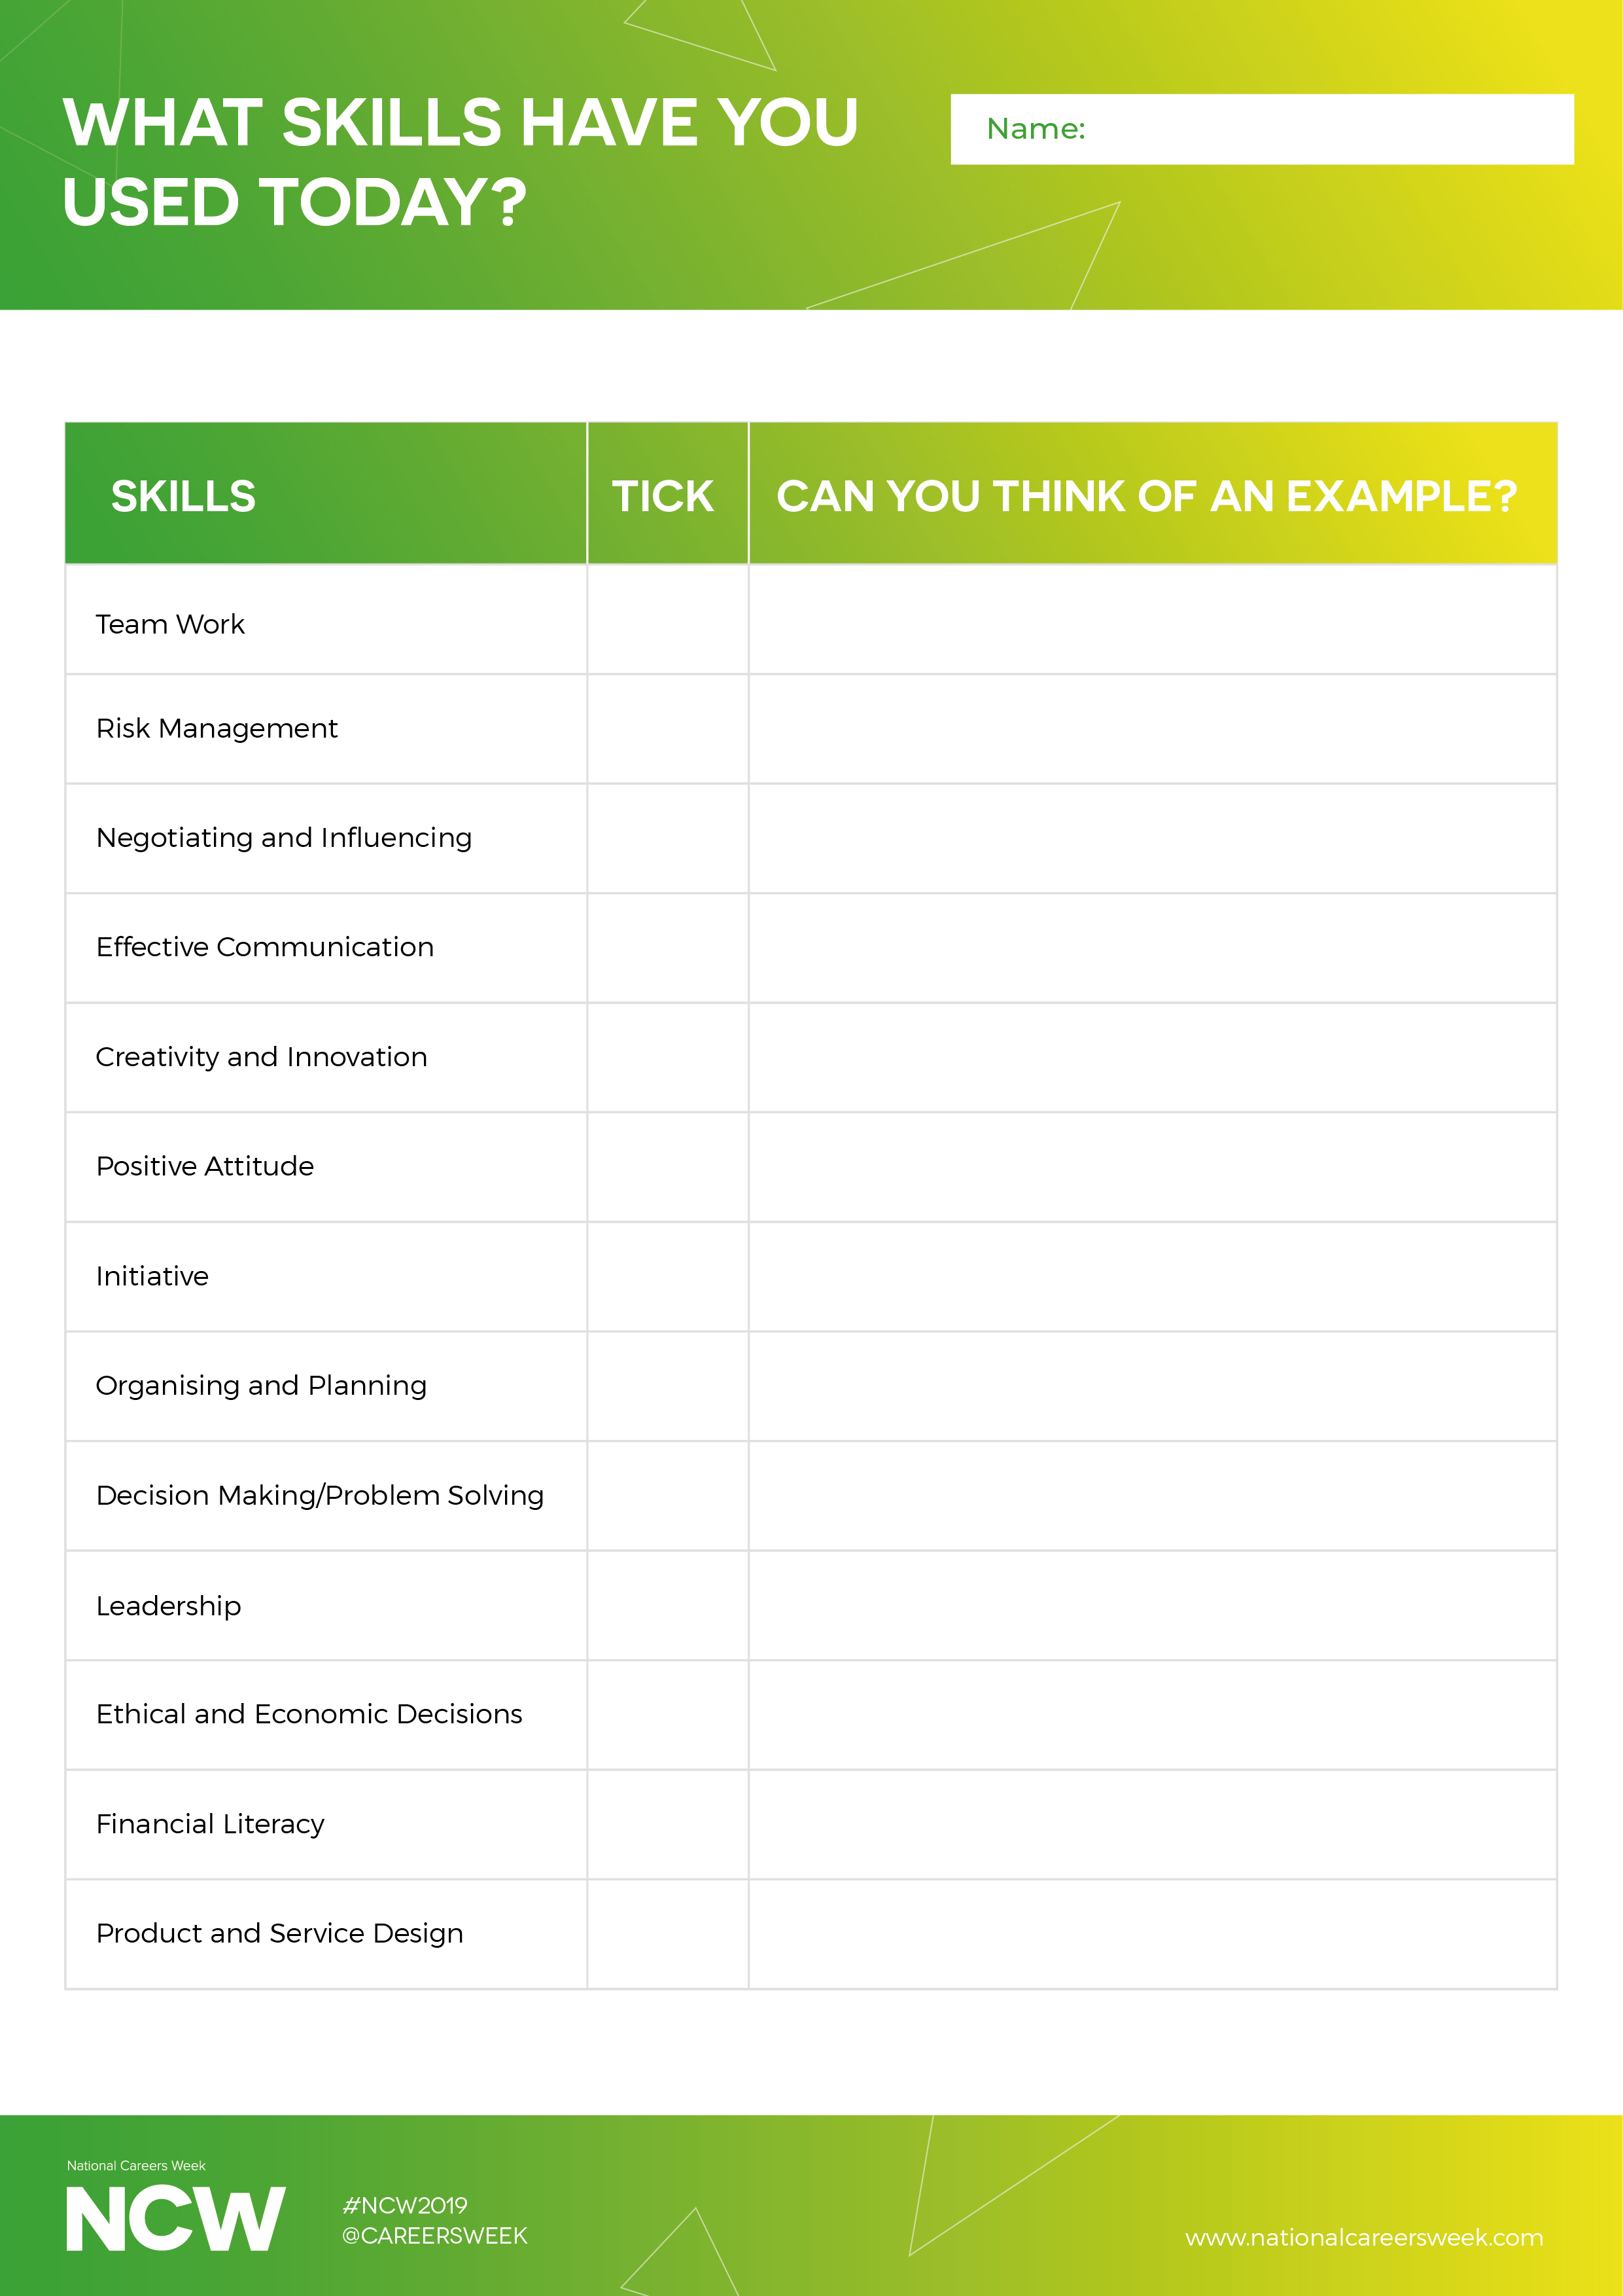
What skills have you used?
How did your group perform?
What could you improve?
Use the sheet provided to fill out the skills you have used!

Slide 13
You have been challenged to construct a free-standing bridge that can a toy car can cross.
The structure must not be fixed to the desk
You can use any of the items in your pack

Slide 14
1 x Stationery Pack
1 x Newspaper
10 x Pieces of card
1 x Toy Car
50 x Straws

Slide 15
Task | Points
Efficiency award | 10
Creativity award | 10
Stability of the Bridge | 1 point per centimetre
All Equipment checked & returned | 5
Teamwork | 5
Toy Car | 20

Slide 16
5 minutes intro
10 minutes discussion & questions (no building during this time)
30 build time
5 minute warning
10 minutes judging

Slide 17
 | Team 1 | Team 2 | Team 3 | Team 4 | Team 5
Team Name
Efficiency award
Creativity award
Equipment
Teamwork
Toy Car

